Slide 1

The Battle of ‘Neighborhoods’
Liverpool & Manchester

Slide 2
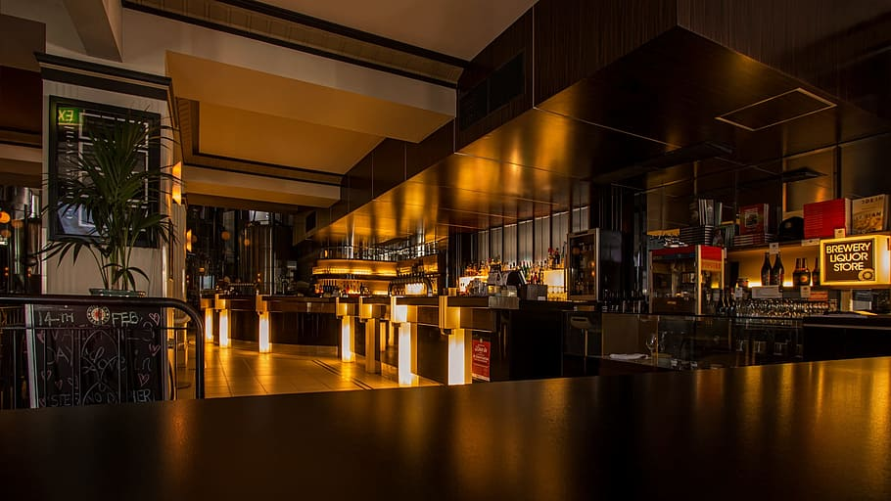
OPENING OF A RESTAURANT
BUSINESS IDEA:
Recommending a firm to open a restaurant in Liverpool city or Manchester.
Shortlisting of places based on the present competition in both the cities by looking for neighbourhoods having lesser frequency of restaurants.
TARGET AUDIENCE: a FIRM asking for recommendation for opening a restaurant in Liverpool or Manchester.
METHOD | TARGET:
if (the frequencies of restaurants in a neighbourhood is less) :
lesser competition + more benefits of opening a restaurant in that location.

Slide 3
DESCRIPTION
Extracting the neighbourhood & coordinates of a city.
Searching for restaurants in the nearby areas and extracting it for each neighbourhood.
Applying k-means to cluster these locations based on the frequency of restaurants available.
Displaying them on a map.
Repeat the same for the next desired city.
Shortlist the neighbourhood for both the cities.

Slide 4

THE DATA SECTION
Wikipedia: extracting neighbourhood for the locations.
Foursquare: extracting venues for each neighbourhood.

Slide 5
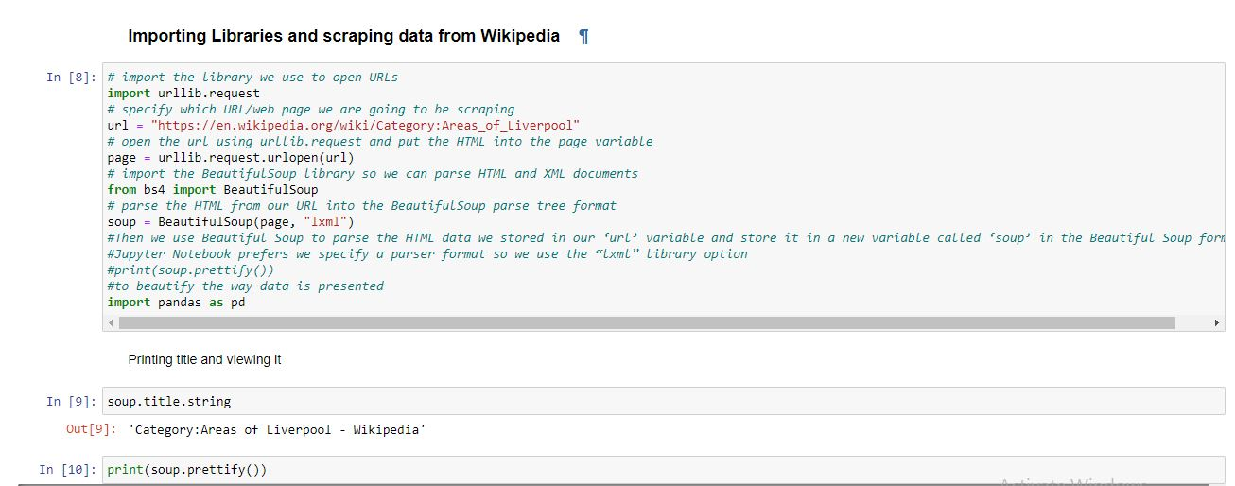
WIKIPEDIA: Here are the codes used to extract data from Wikipedia and store it in a dataframe

Slide 6
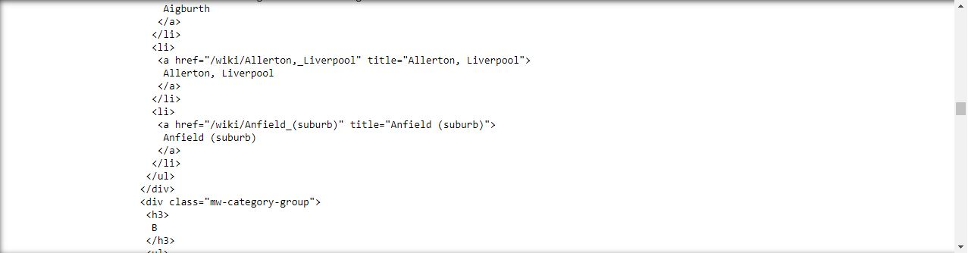
RESULTS OF THE DATA RECEIVED:

Slide 7
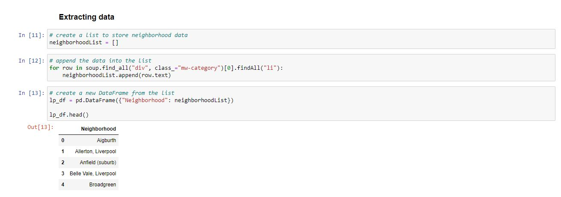
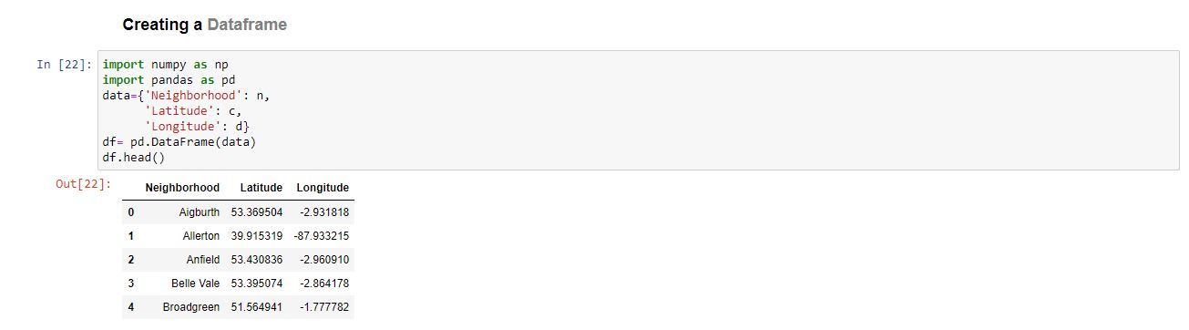

Slide 8
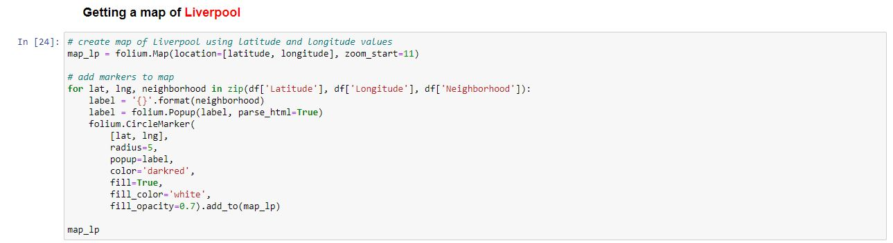
Displaying the Neighborhoods

Slide 9
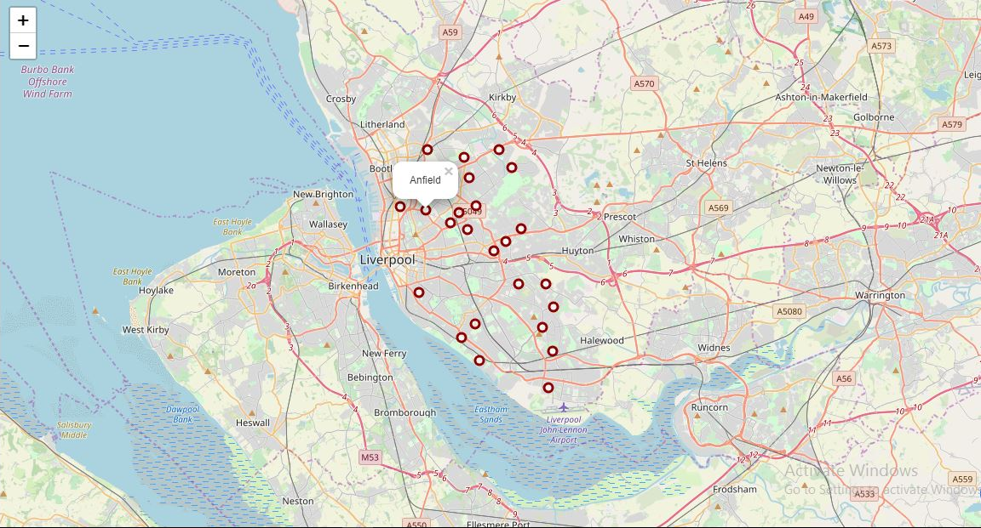

Slide 10
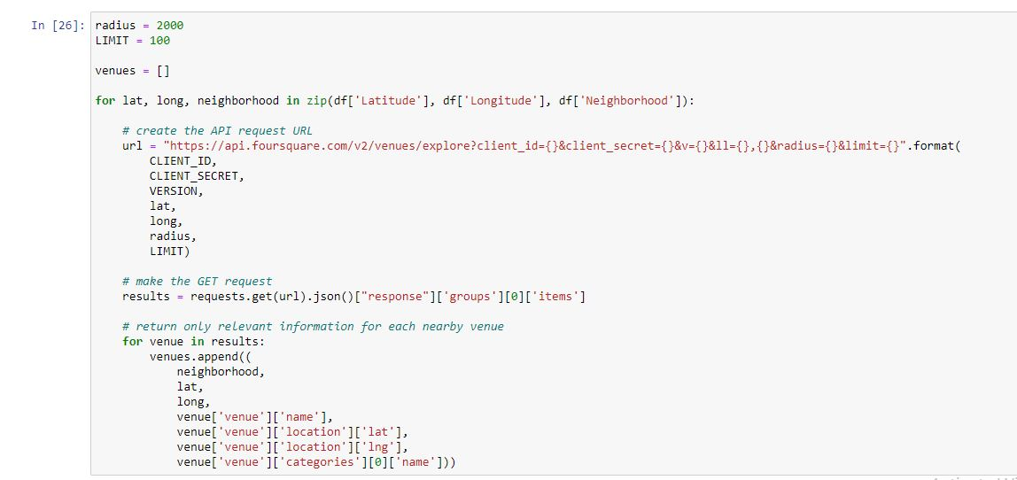
FOURSQUARE: Here are the codes utilising Foursquare API calls:

Slide 11
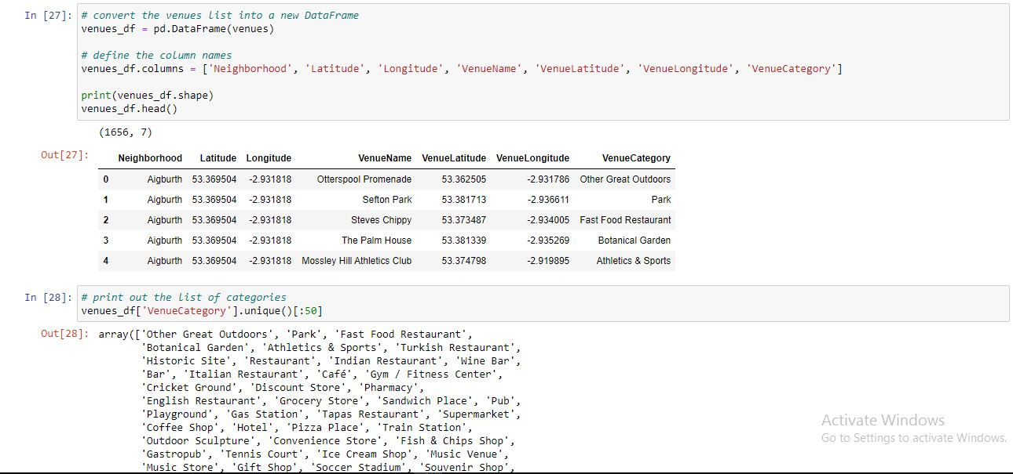
Storing the data collected in a data frame and viewing the categories.

Slide 12
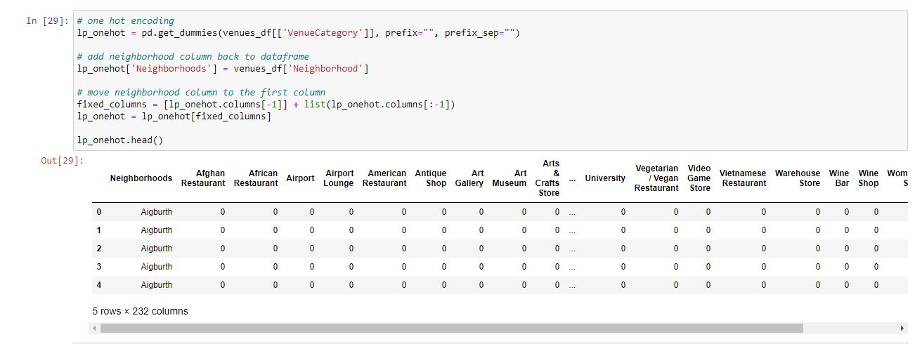

Slide 13
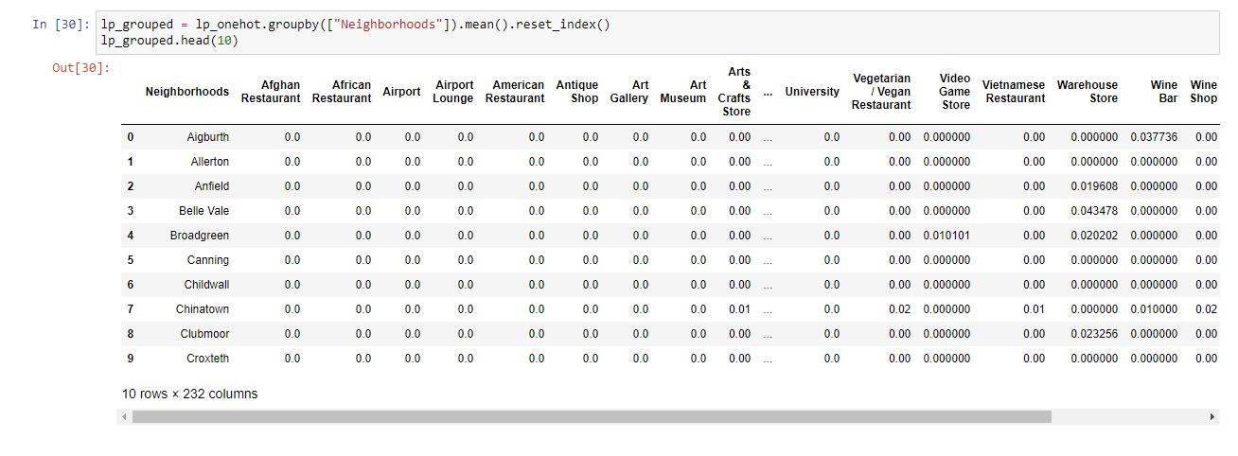
Taking the frequencies of each venue in a location

Slide 14
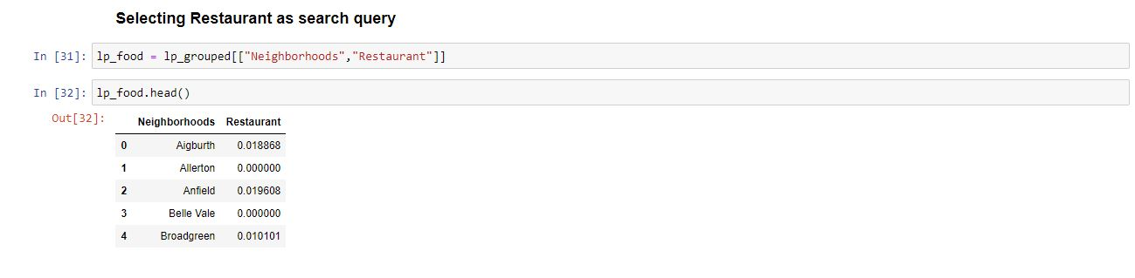

Slide 15
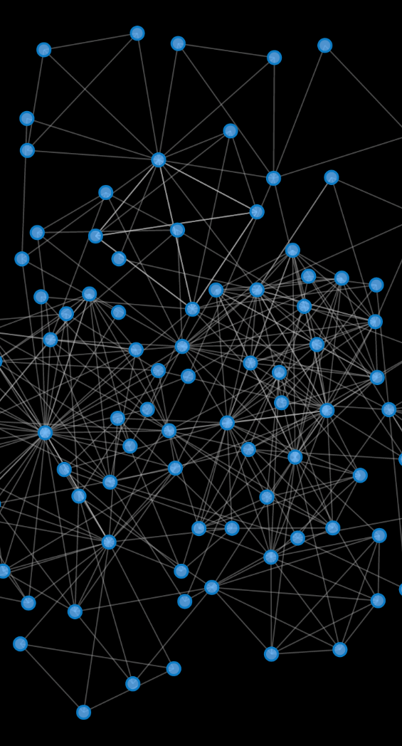
METHODOLOGY
In this project the use of k-means clustering is done.
One of the algorithms that can be used for segmentation is K-means clustering.
K-means can group data only unsupervised based on the similarity of customers to each other.
K-means is a type of partitioning clustering.
That is, it divides the data into k non-overlapping subsets or clusters without any cluster internal structure or labels. This means, it's an unsupervised algorithm.
Objects within a cluster are very similar and objects across different clusters are very different or dissimilar.

Slide 16
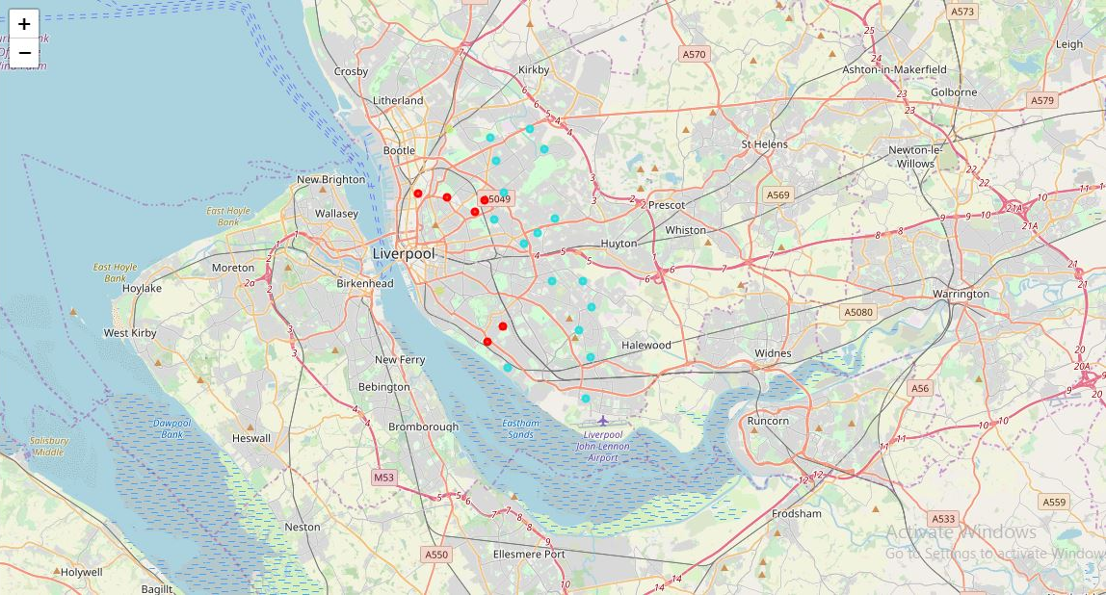
For Liverpool

Slide 17
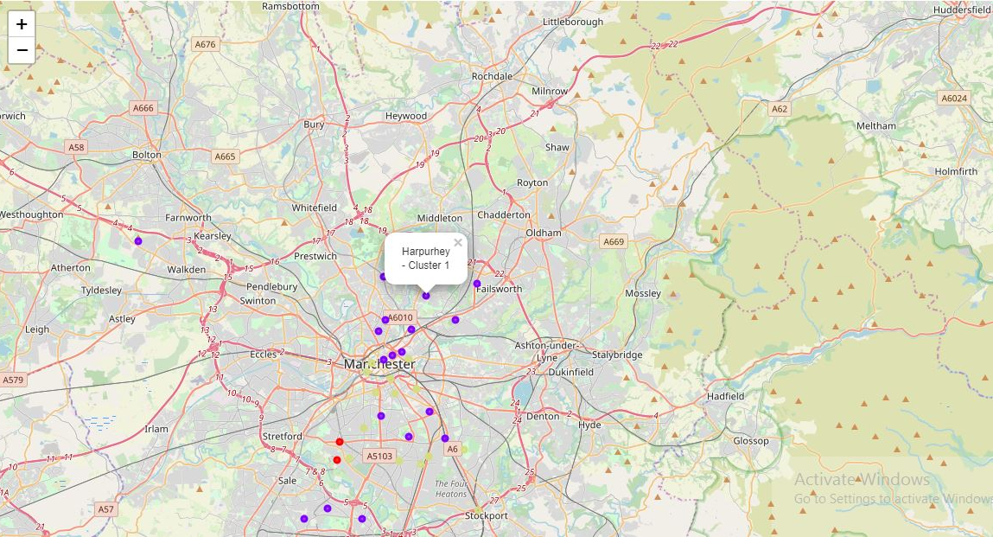
For Manchester

Slide 18
RESULT: Shortlisting the places
In the end the neighbourhood from both the cities having less frequency of restaurants were chosen.
This closes the loop, satisfying the initial condition:
if (the frequencies of restaurants in a neighbourhood is less) :
lesser competition + more benefits of opening a restaurant in that location.

Slide 19
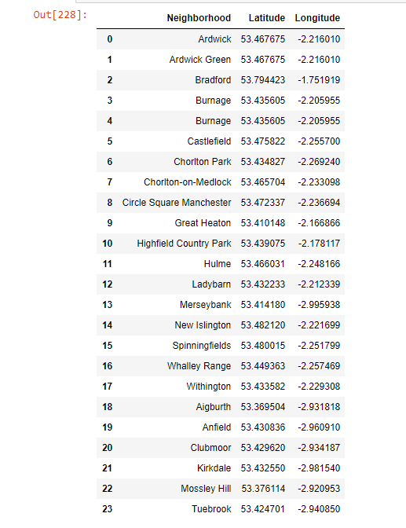

Slide 20
CONCLUSION
Got the shortlisted places in a single data frame.
Providing the firm with the beneficial location in their desired cities and now its up to to them to choose from.

Slide 21
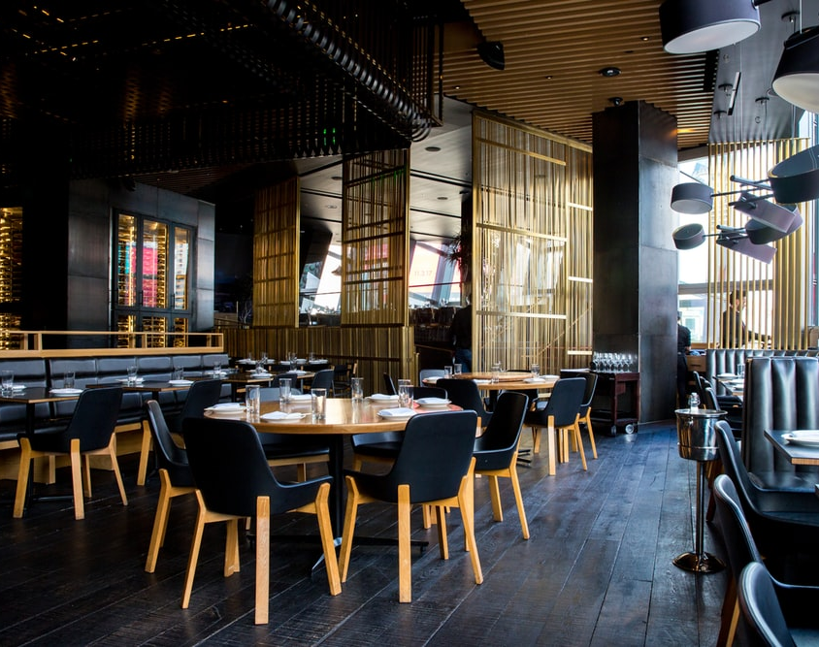
THANK YOU

